Slide 1
Stream Restoration
Examples of how streams respond to restoration

Slide 2
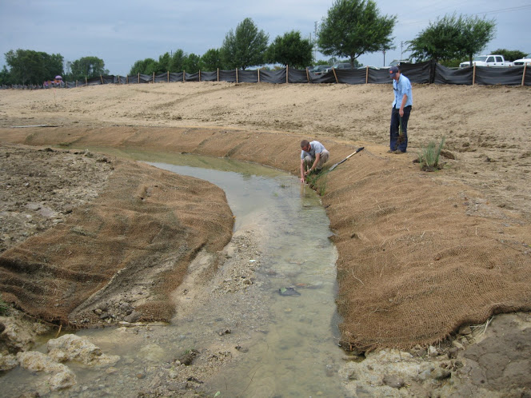
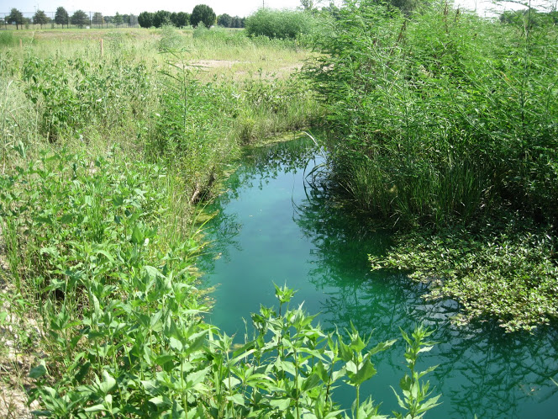
A restored urban stream in Alabama
The stream channel was made of cement and was straight. There were no trees close to the stream.
The cement is removed and curves were added. Native plants were planted.
After several years, plants have grown and the stream meanders.

Slide 3
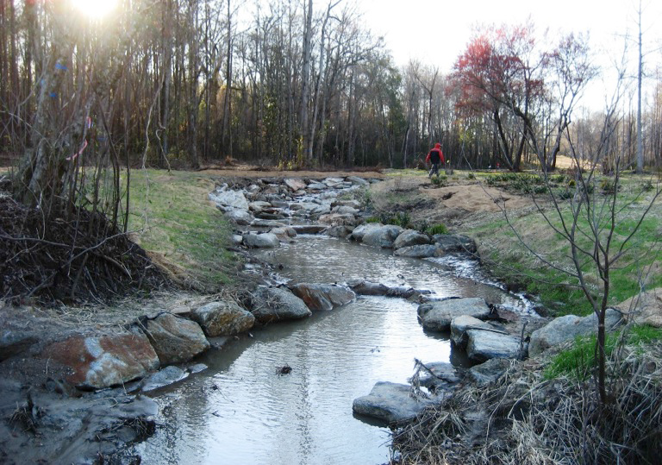
Instream Structures ~ logs, boulders
Adding logs and boulders helps deflect water from the streambanks. This decreases erosion and sedimentation.
The instream structures also make good habitat for plants, insect, fish, and other animals.

Slide 4
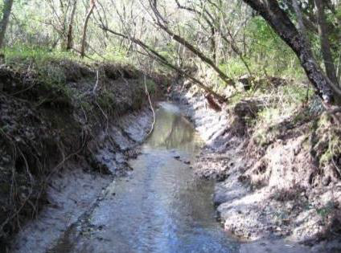
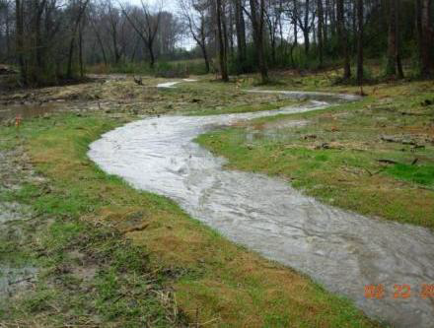
This stream in Alabama was disconnected from its floodplain. Flood water had nowhere to go, so it cut a deeper channel. Water also eroded the stream banks, making them unstable. Trees were falling over.
To restore the stream, people reshaped the banks, so that water can go into the floodplain during high flows. Curves (meanders) were also added.
Both of these changes decreased the energy of the flood water. Less energy in the water means less erosion.

Slide 5
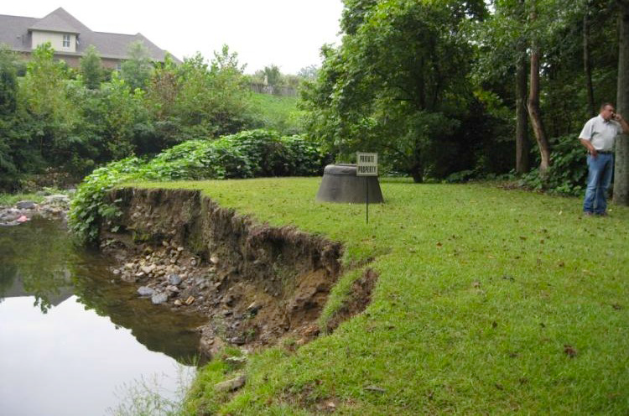
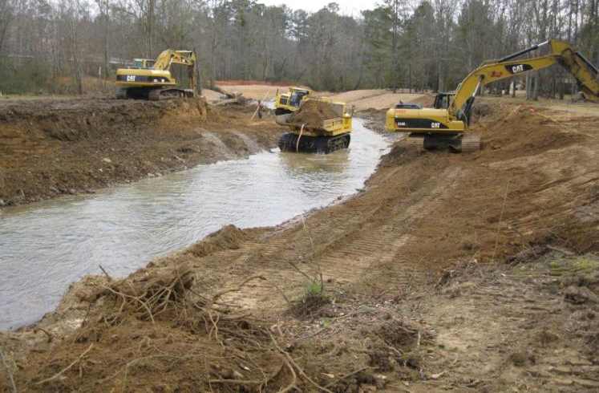
Another example of a stream getting deeper and the banks becoming unstable.
At first, when restoration work begins, it looks like a mess. But the new channel shape gives the water more area to flow into during floods. The water spreads out, slows down, and causes less damage.
.

Slide 6
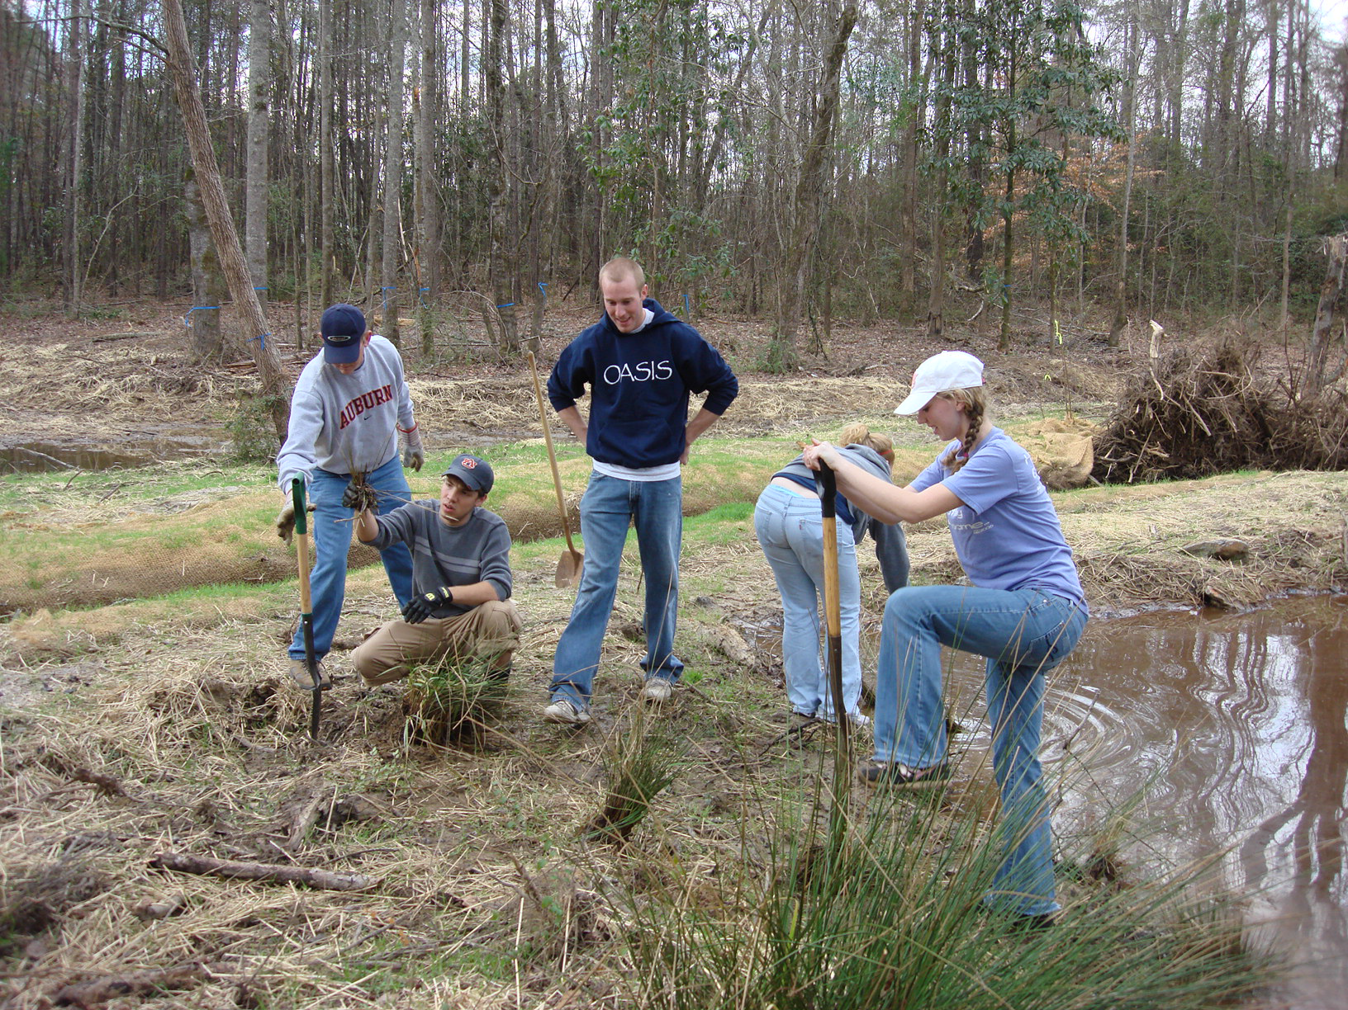
Stream restoration gives people a chance to work with others to improve their community and the natural environment.

Slide 7
People care more about a stream after they help to restore it. They become personally invested, and continue to protect it into the future.

