Slide 1
Colgan Creek Restoration
Long ago, Colgan Creek flowed freely, unrestricted by man-made channels. When Santa Rosa was a growing city, people made the stream sections straight and took away the historic floodplain.
In the summer of 2014, people worked to make a section of Colgan Creek more like the natural stream it used to be. This is called stream restoration.
The results can be seen already. The once-straight channel now curves. There is a sloping floodplain next to the stream, and young, native plants growing alongside the stream.

Slide 2
The problem was...
The creek had no floodplain where water could spread out during a flood.
The creek was confined on both sides.
Plants were growing in the stream channel, so there was less space for water during high flows. Water could overflow the banks and flood homes and streets.
The riparian plants were not diverse, did not give enough shade, and some were not native.

Slide 3
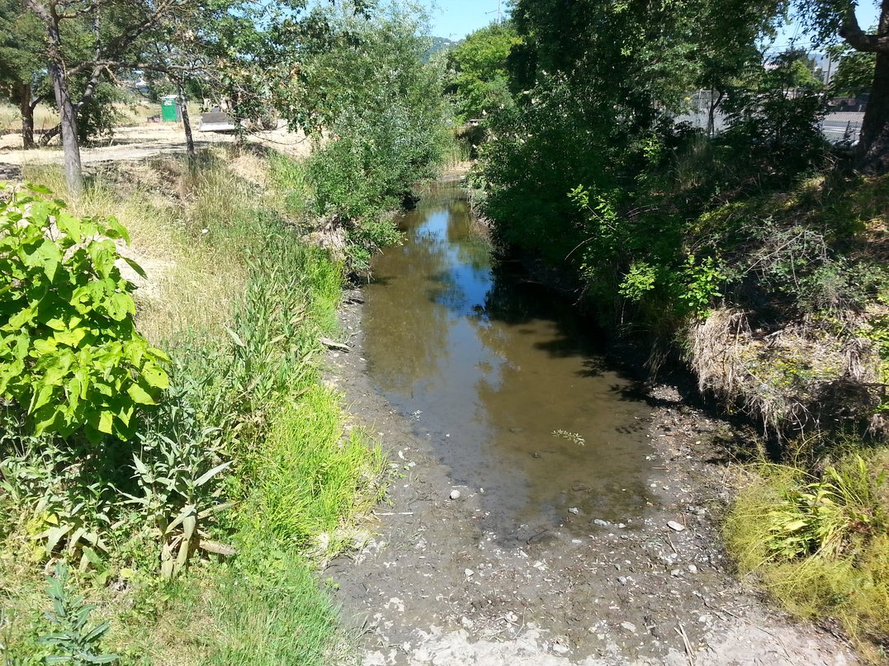
July, 2013
This is Colgan Creek before restoration. We are looking upstream, from the bridge at Burgess Avenue. The creek is straight and the channel is confined by roads on both sides.

Slide 4
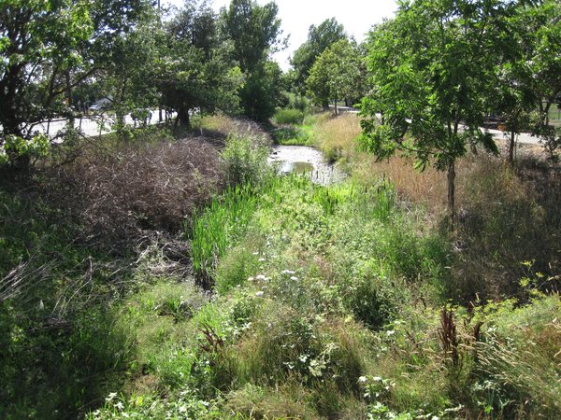
Plants were growing in the stream channel. This leaves less room for water when there are high flows.

Slide 5
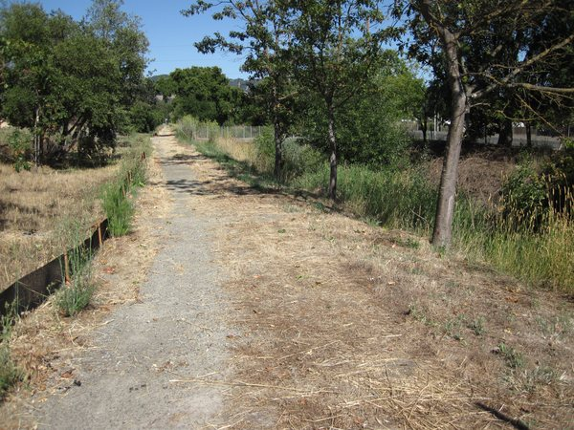
The stream was straight, like the road beside it. There were not many trees and the stream was confined in a narrow channel, to the right of the road. This area was widened to create a flood plain.

Slide 6
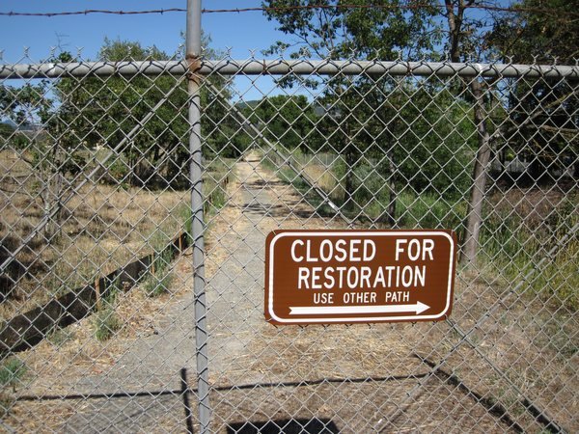
The restoration work was done during the summer of 2014.

Slide 7
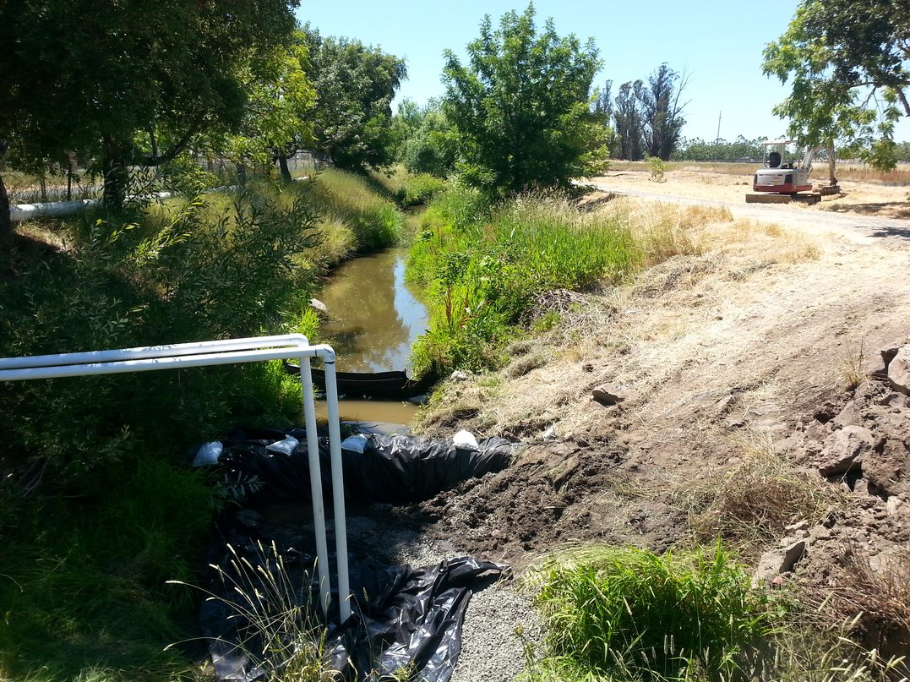
July, 2014
The summer of 2014 was dry, but the creek still had some water in it. This had to be removed before the work could begin. The water was diverted into a large pipe (upper left) that carried it past the site.

Slide 8
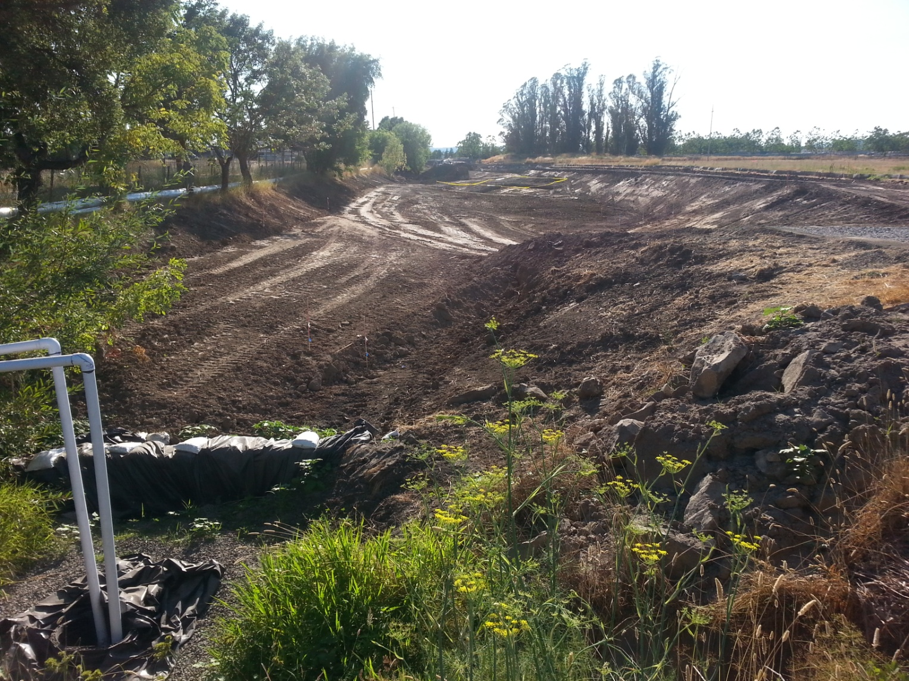
All the creek water is now flowing in the large pipe and the streambed is being reshaped.

Slide 9
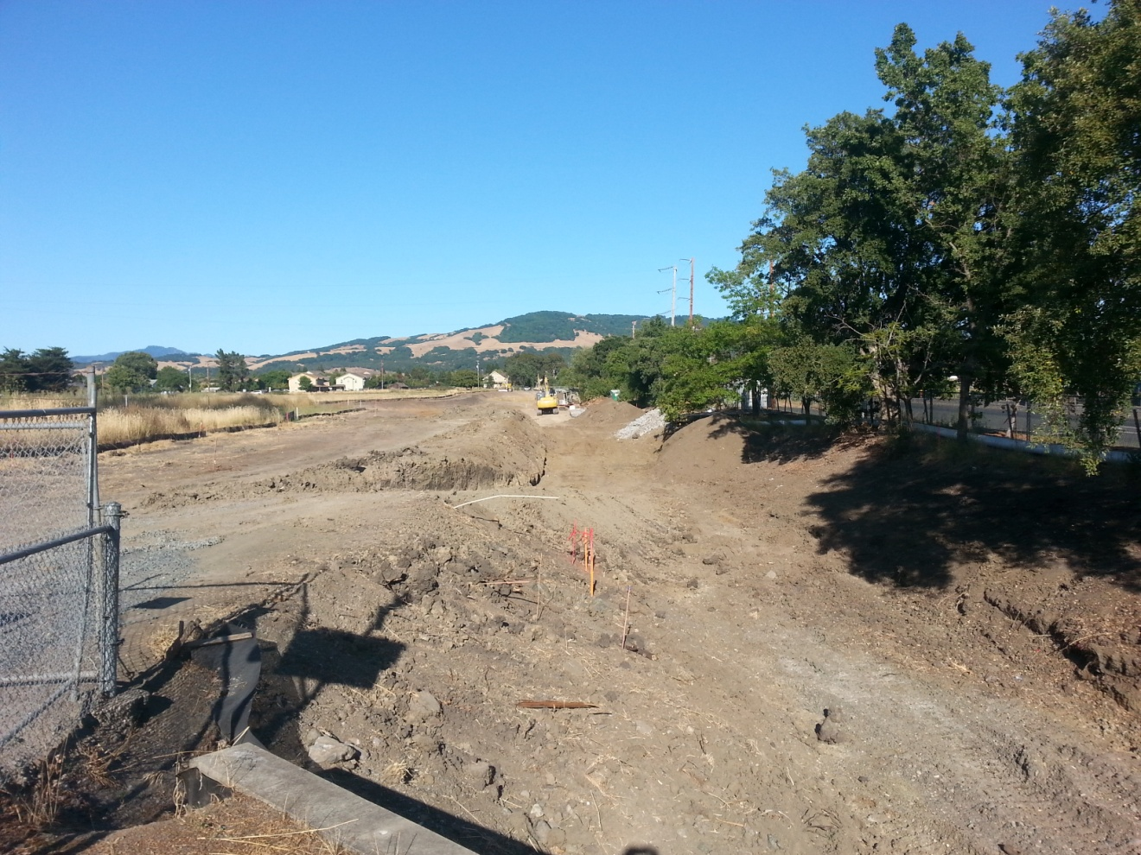
Looking toward Taylor Mountain (upstream). The dirt road that runs along the stream on the left side is being removed so the channel can be made wider. The road on the right side is Bellevue Avenue.

Slide 10
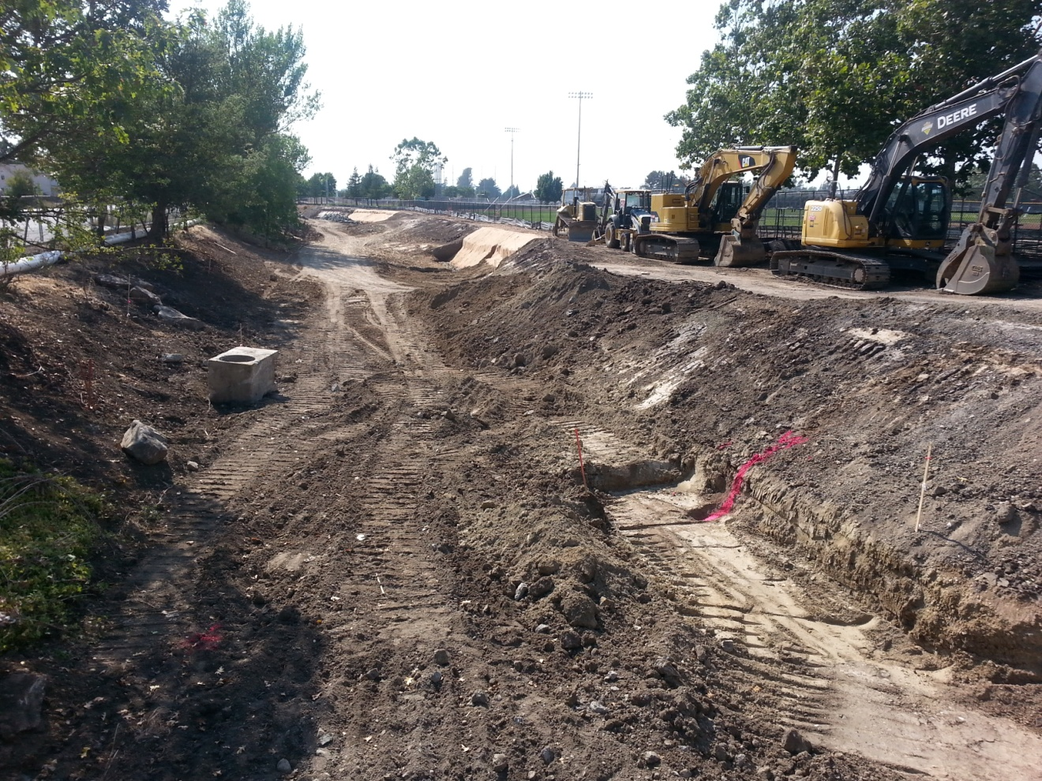
Widening the channel and sloping the bank.

Slide 11
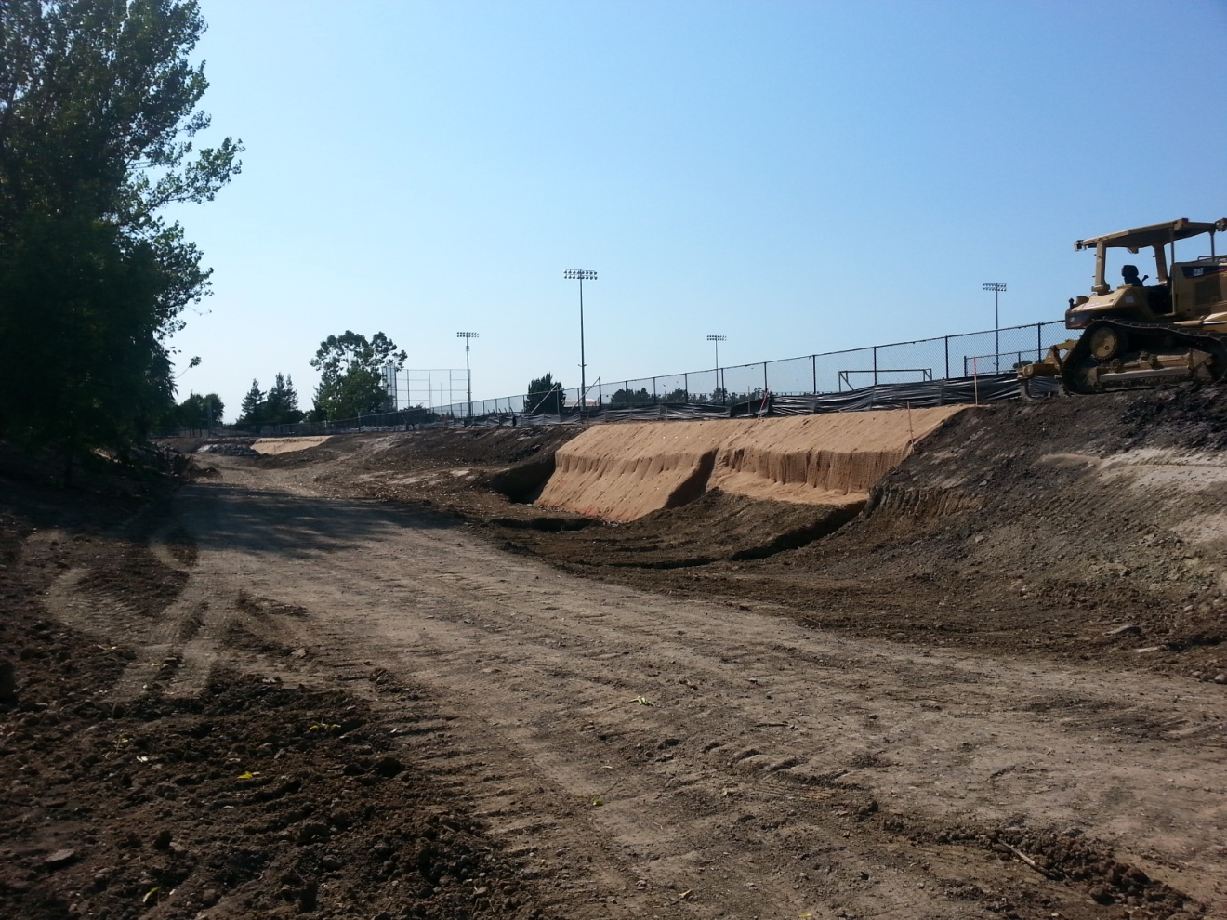
A blanket made of natural fibers covers the bare soil, to reduce erosion.

Slide 12
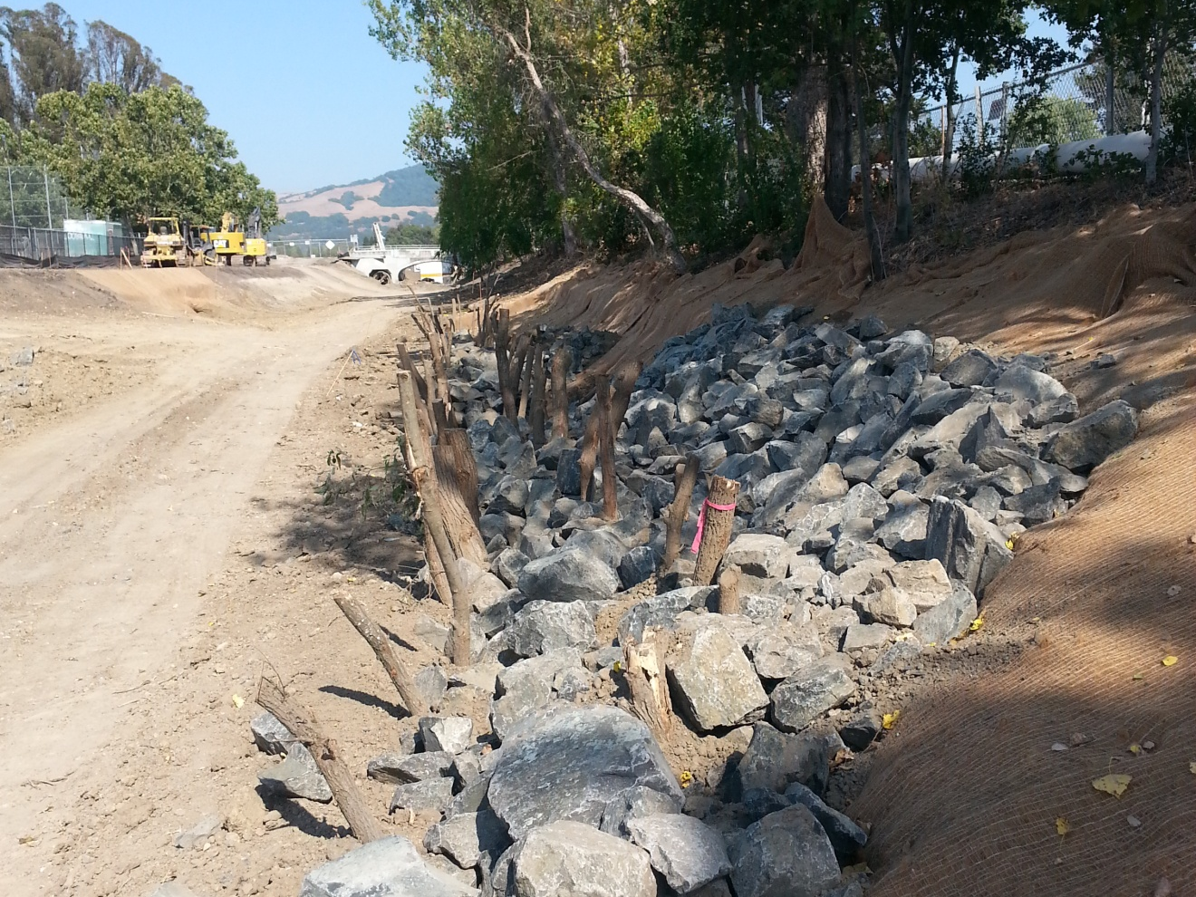
New boulders along the stream bank will help deflect the water and decrease erosion.

Slide 13
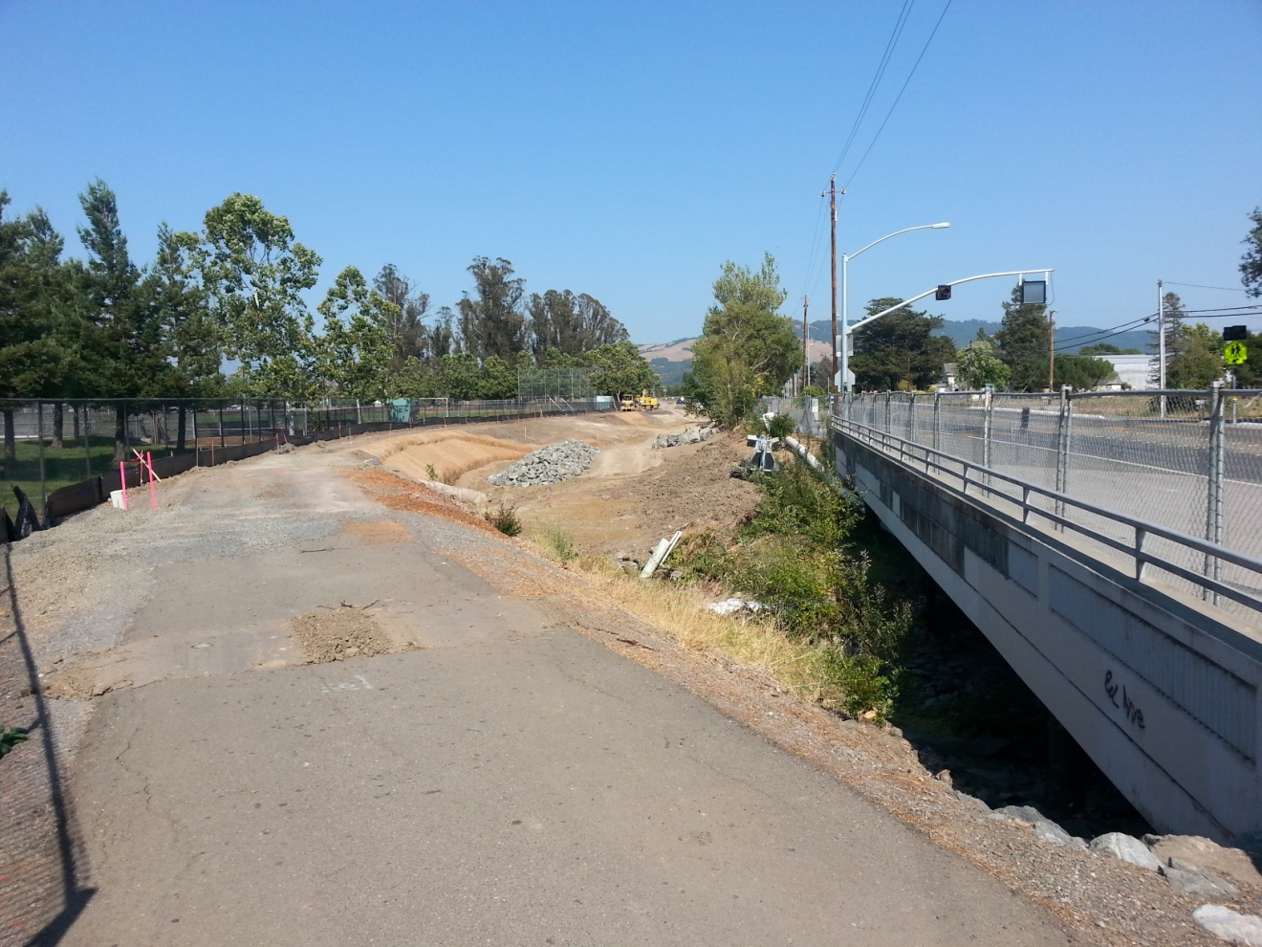
This is the creek at the place where it goes under Bellevue Avenue. Elsie Allen High School is to the left. The next photo is a close-up of this site.

Slide 14
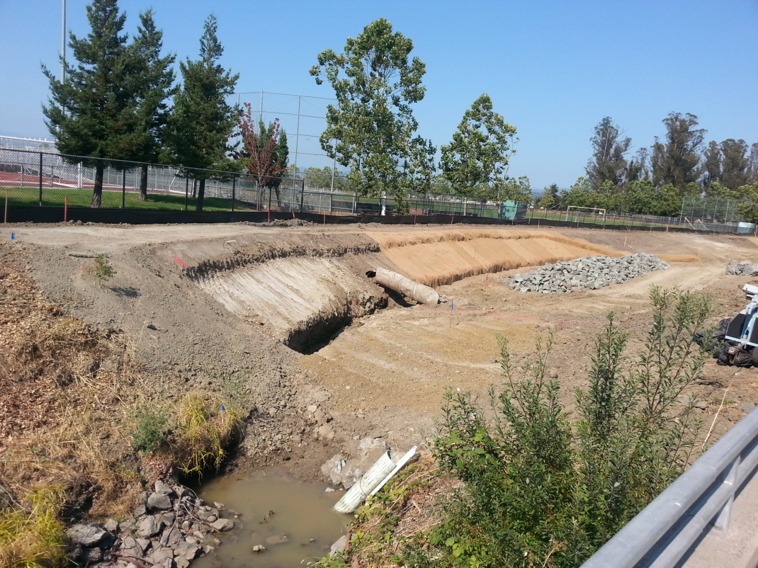
Reshaped channel at Bellevue. Notice the fiber netting placed over the bare streambank. This will help reduce erosion until the plants grow. The boulders will armor the bank.

Slide 15
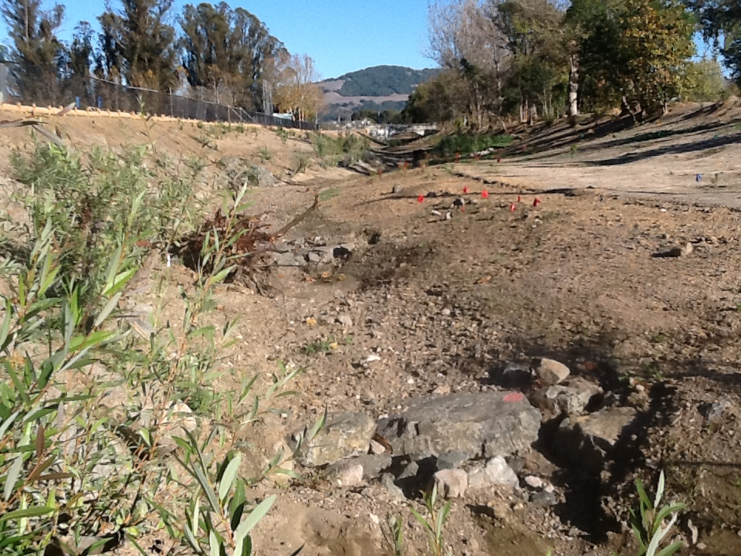
Willow starts were planted right away, and they are already beginning to grow. Red flags mark the spots where other plants are taking root.

Slide 16
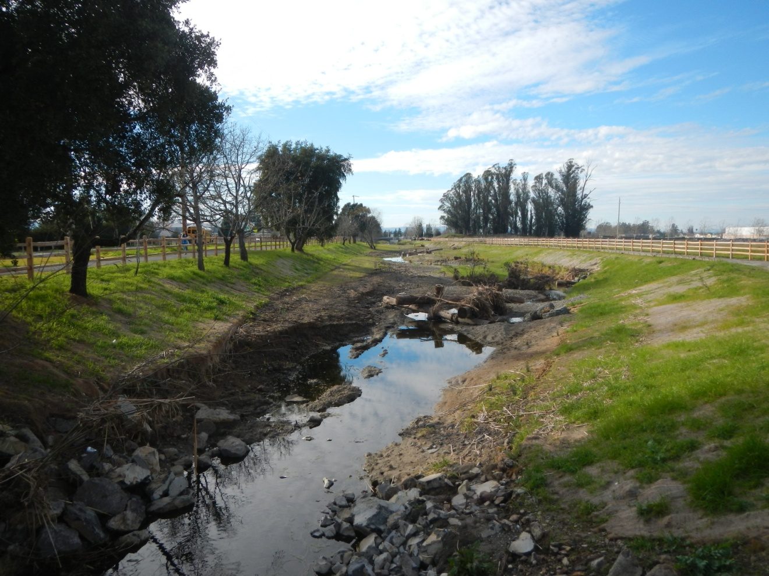
January, 2015
This is looking downstream from Dutton Meadow, six months after the restoration work. The channel is wider and connected to the flood plain, to the right. Logs and boulders will protect the banks and provide new habitat.

Slide 17
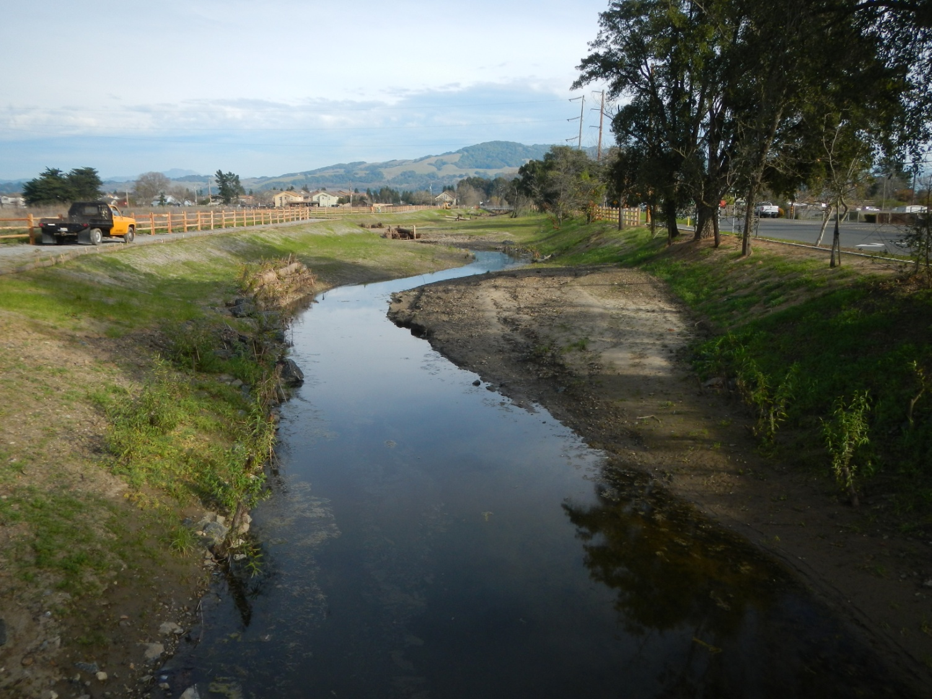
The creek now has curves that will help slow down the water. Logs and boulders on the outside of these curves will protect the streambanks.

Slide 18
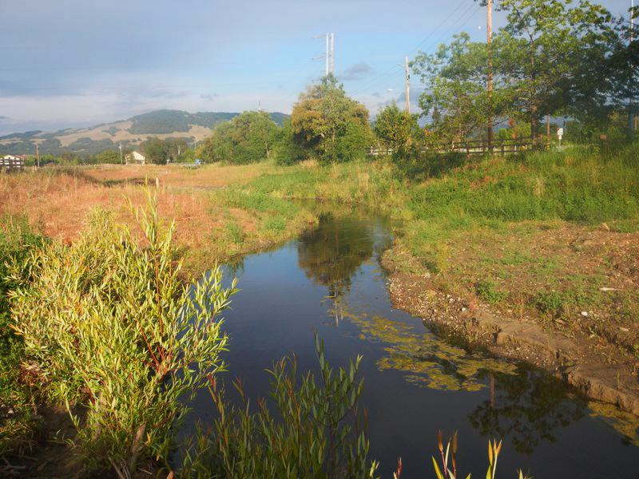
May, 2015
Looking upstream from a spot near Burgess Avenue.

Slide 19
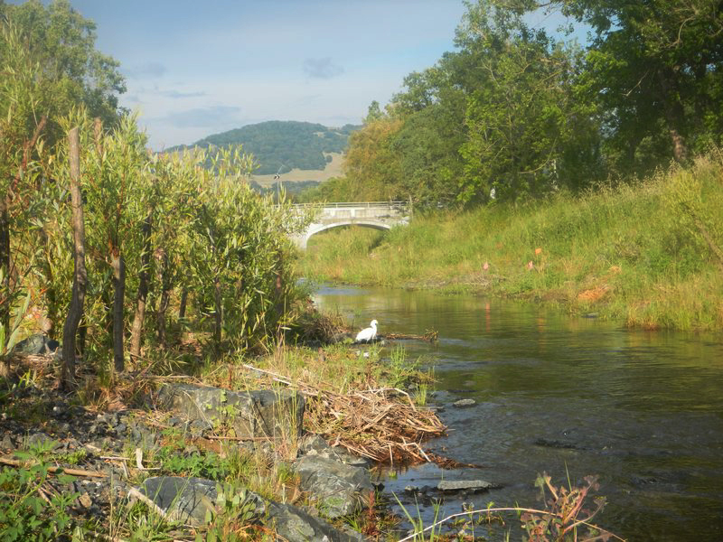
Willows grow long the left bank. By this time next year (2016) they will be shading the stream.

Slide 20
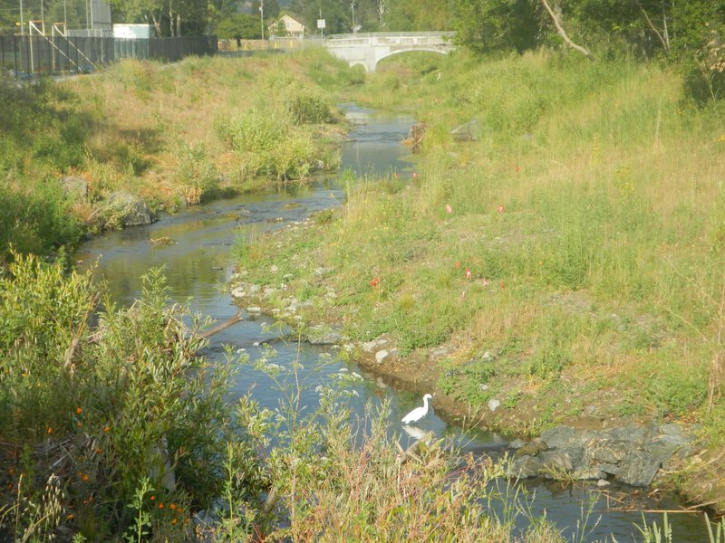
Birds, like this egret, will benefit from the creek’s restoration.

Slide 21
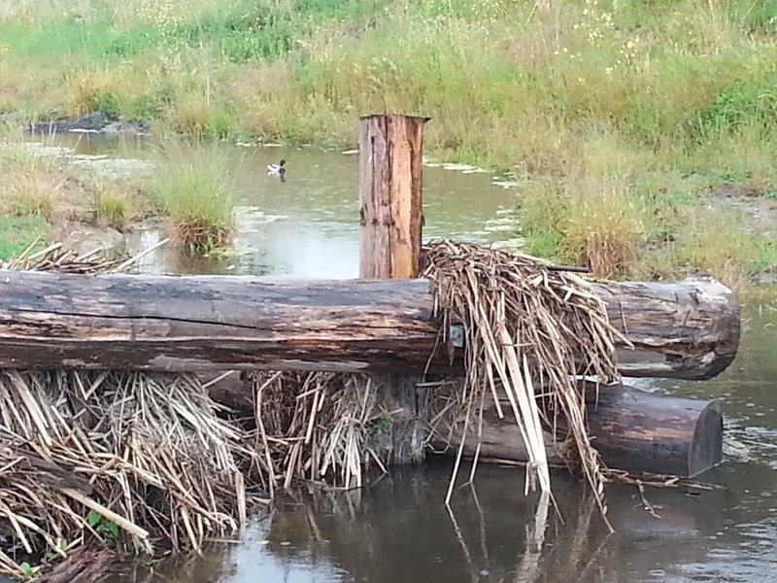
Newly placed structures, like these logs, will create more diverse habitat and help slow down the water during high flows.

Slide 22
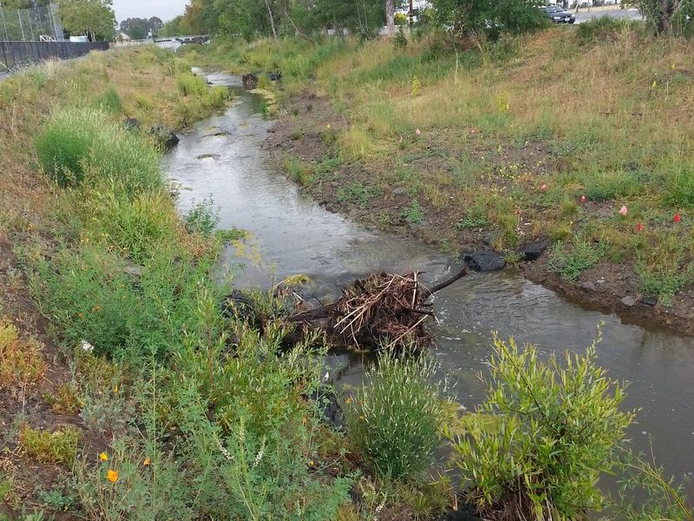
The stream channel is no longer choked with plants. Large wood and boulders divert the flowing water away from the banks.

Slide 23
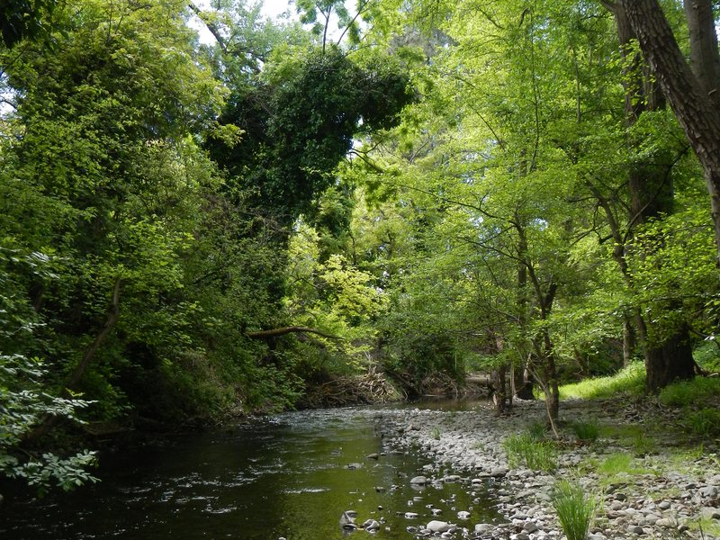
How will Colgan Creek look in 20 years? Maybe a little bit like Santa Rosa Creek (above). The large trees will make a shady refuge for people, birds and aquatic life.

