Slide 1
A Tour of Colgan Creek
From the Headwaters to the Laguna de Santa Rosa

Slide 2
The Headwaters
The headwaters of Colgan Creek come from two different branches. One branch flows from Taylor Mountain and is above ground. It is call Kawana Springs.
The other branch begins just above the Sonoma County Fairgrounds. This part of the creek flows inside a concrete pipe that is below the streets, so you cannot see the creek. But it is there. All the water entering the storm drains goes into the creek underneath.
The two stream branches come together at the Colgan Creek box culvert, near the Costco Store. From this point on, it is called Colgan Creek.

Slide 3
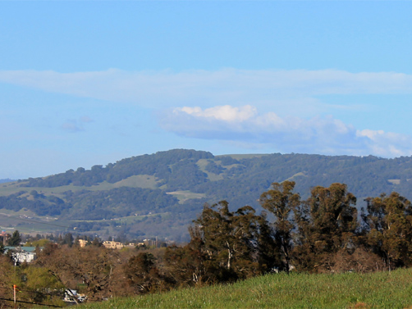
Kawana Springs flows from the northern side of Taylor Mountain.

Slide 4
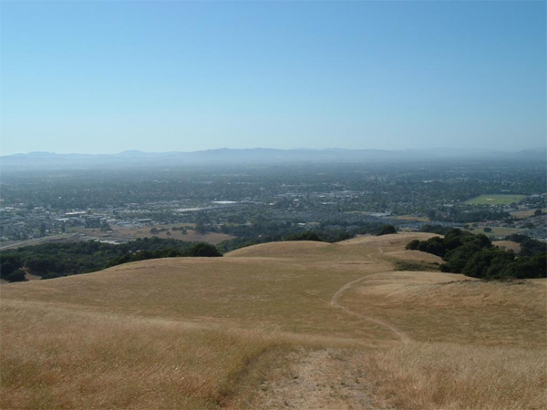
The mountain is not developed. It has open space, with grasslands and oak trees. Santa Rosa spreads out below.

Slide 5
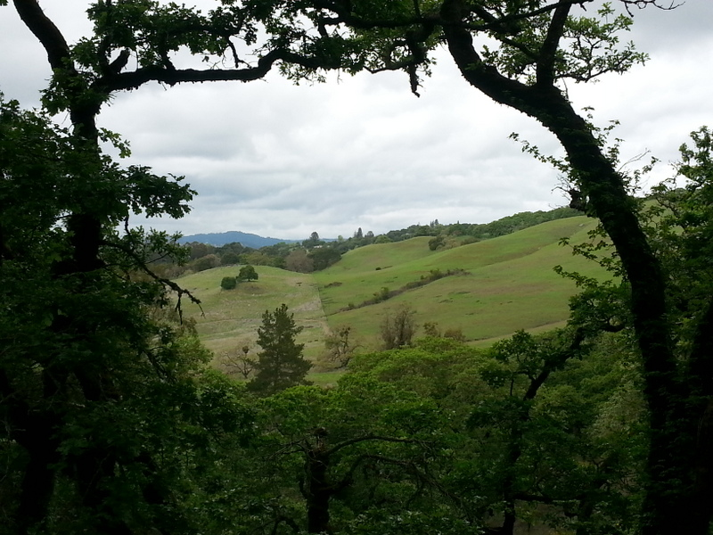
Looking out from Taylor Mountain.

Slide 6
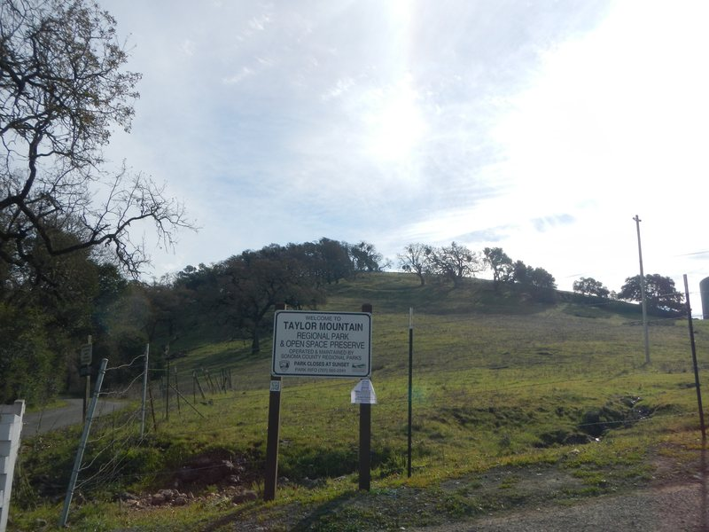
The entrance to Taylor Mountain Park. Kawana Springs is nearby, to the left.

Slide 7
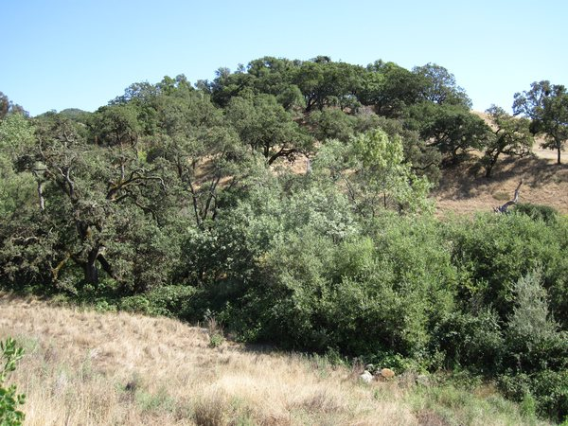
There is a good canopy of oak and willow trees shading upper Kawana Springs.

Slide 8
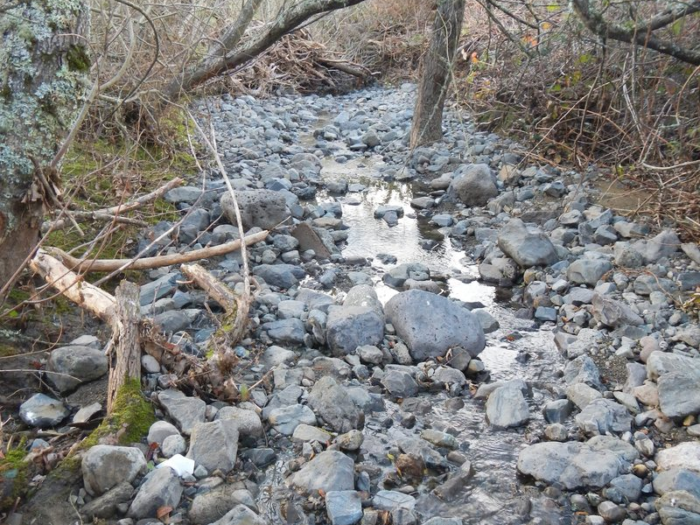
The upper section of Kawana Springs has a gravel bottom. Steelhead trout could spawn here, with enough water.

Slide 9
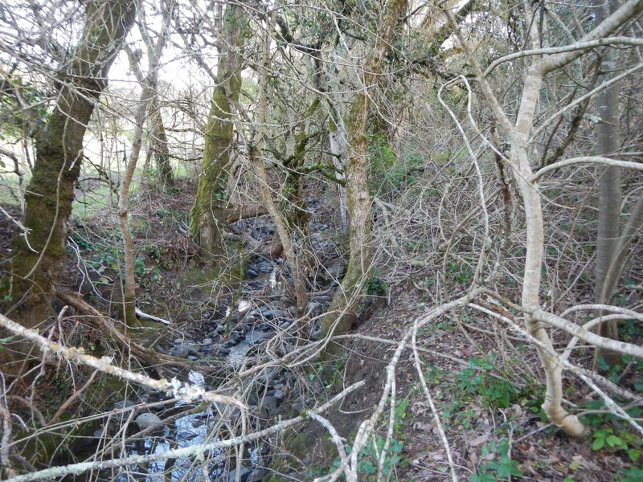
Upper Kawana Springs has a fairly good riparian zone. In the summer, these trees will shade the water and keep it cool.

Slide 10
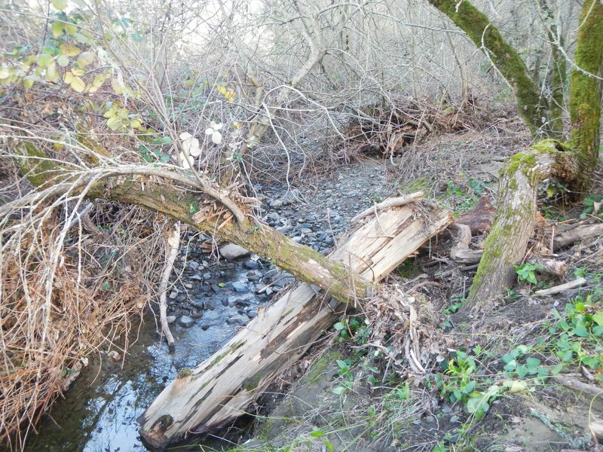
This large log will be underwater during high flows. It could give fish a place to rest. Fish could also hide from predators under it.

Slide 11
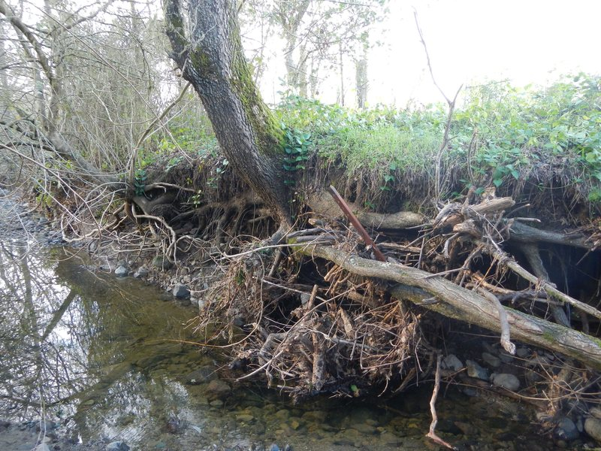
Riparian tree roots help keep the streambank in place.

Slide 12
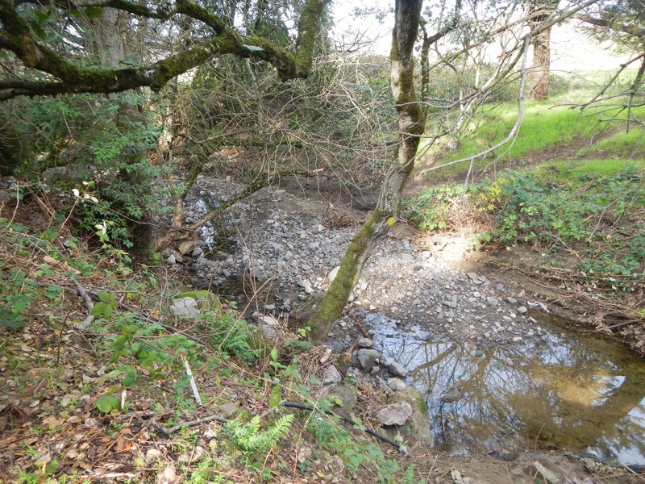
The creek along Kawana Springs Road. This section has a gravel bottom and shade from trees. There are many birds here.

Slide 13
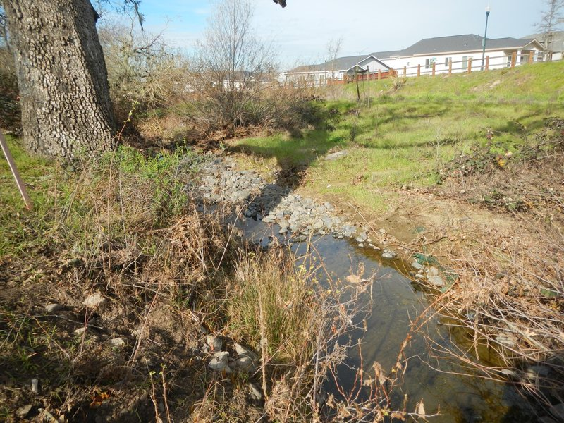
Kawana Springs and homes on Kawana Springs Road.

Slide 14
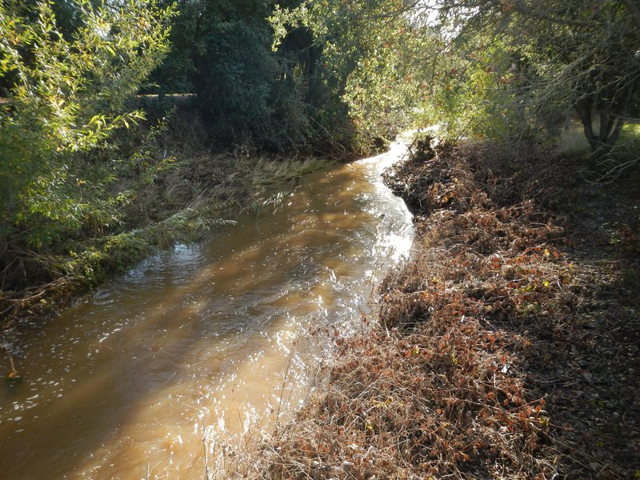
Kawana Springs at Petaluma Hill Road, during high flows.

Slide 15
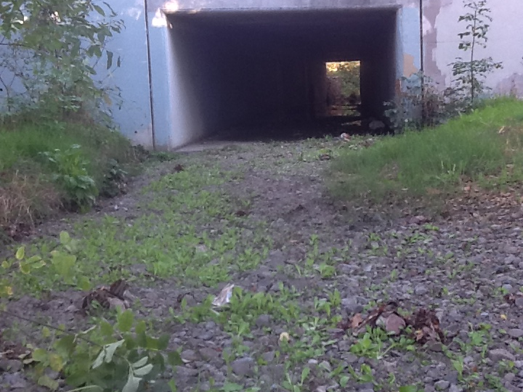
Kawana Springs flows under Petaluma Hills Road, through this culvert. This picture was taken in the summer, when the stream was dry.

Slide 16
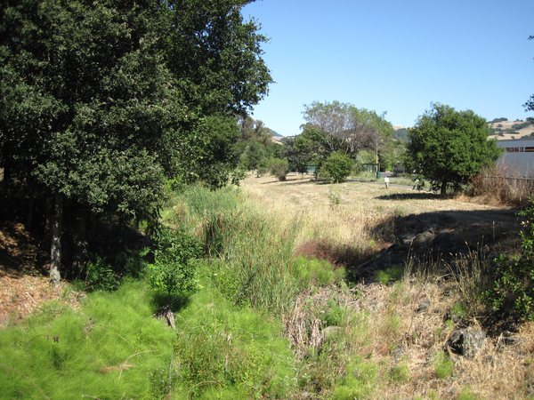
This section is between Petaluma Hill Road and Colgan Avenue. There has been some restoration done here. Part of the Costco building is visible to the right.

Slide 17
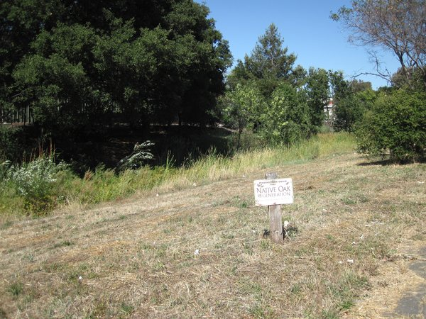
This is the stream behind the Costco store. Native oak seedlings are growing here. People planted them to restore the riparian area.

Slide 18
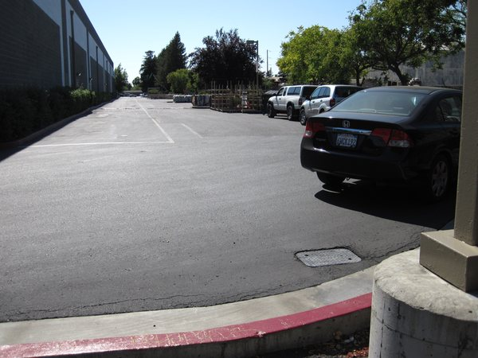
The stream goes under this parking lot for a short distance. It is in a cement culvert.

Slide 19
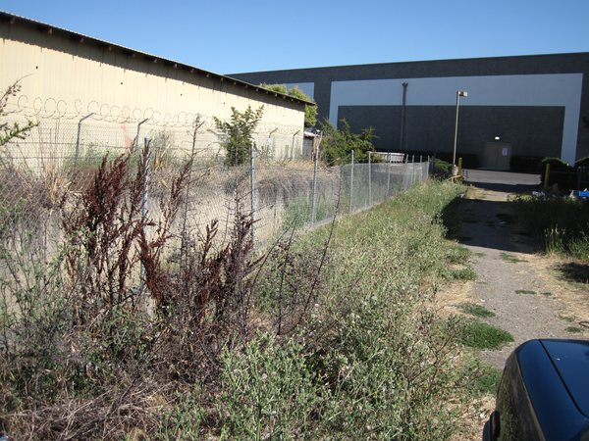
This is on the downstream side of the parking lot. The stream is above ground again.

Slide 20
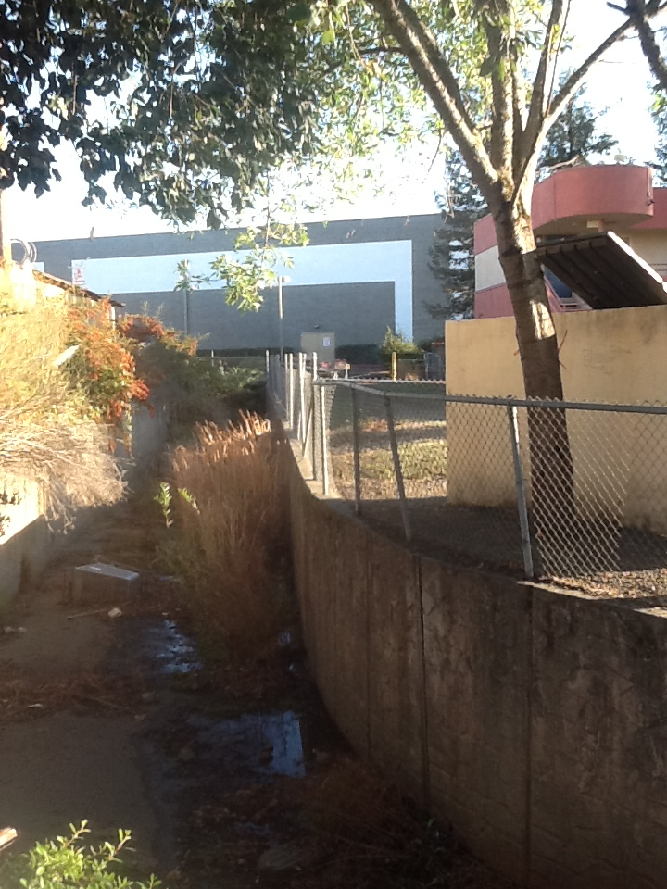
Just downstream of the parking lot, the stream is confined in a concrete channel.
There are weeds and trash in the stream. These are not healthy conditions.

Slide 21
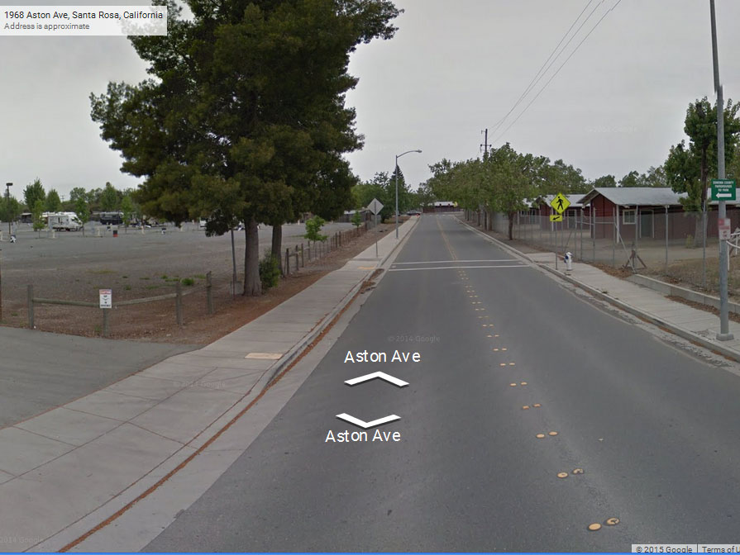
The other branch of Colgan Creek begins in the area of town near the Sonoma County Fairgrounds. All the water that flows off the land goes into storm drains and into a pipe underground. The water is flowing downhill, underneath this street

Slide 22
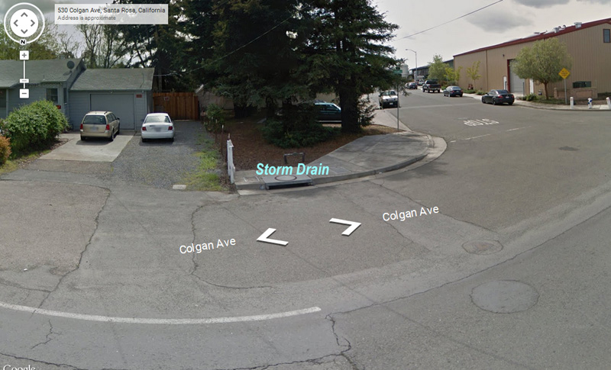
This is farther downhill from the fairgrounds, on Colgan Avenue. Notice the storm drain. All the water flowing into the storm drain goes into Colgan Creek.

Slide 23
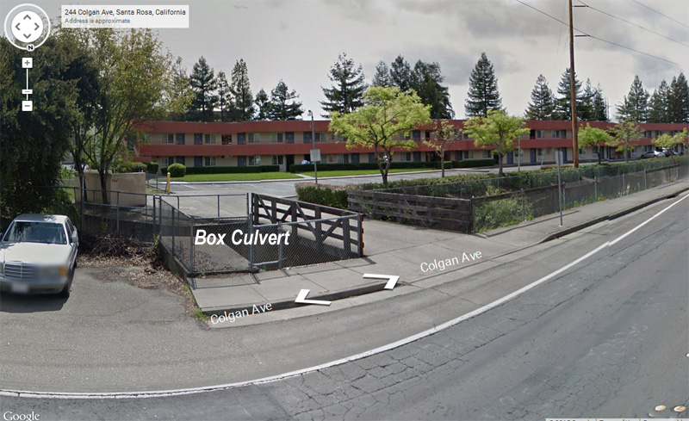
Farther down Colgan Avenue is the box culvert, where the water flowing under the street will converge with Kawana Springs. From this point on, it is called Colgan Creek and it flows mostly above ground.

Slide 24
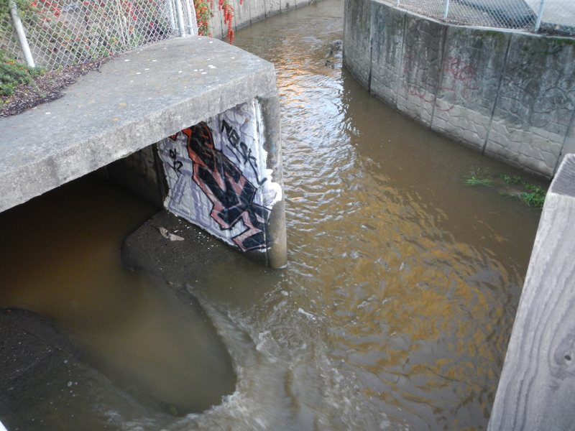
The Colgan Creek Box Culvert, where Kawana Springs joins the water coming through the underground pipe from the neighborhoods around the fairgrounds and Colgan Avenue.

Slide 25
The steam flows through neighborhoods, past homes, schools, shopping malls, industry and parks.
It flows under Highway 101 and under city streets.
Many sections of the stream are in concrete channels. The sections without concrete are unnaturally straight.
The stream bottom is mostly sand and fine silt, with some pieces of broken concrete.
The middle section of Colgan Creek

Slide 26
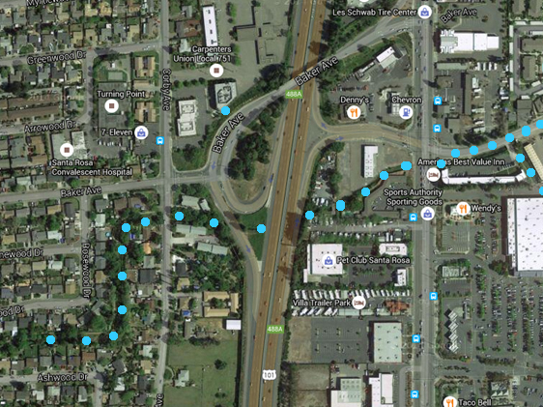
The creek flows along Colgan Avenue, then passes under Highway 101.
It passes under Corby Ave and then zig-zags through residential streets.

Slide 27
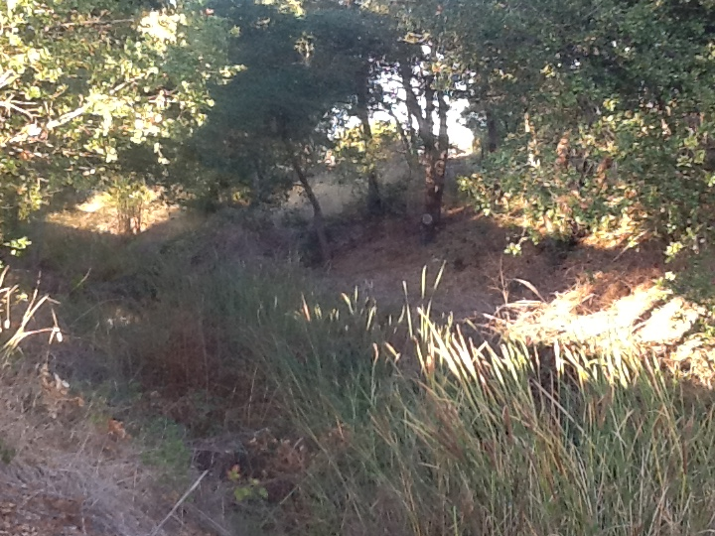
Colgan Creek at Hearn Avenue.

Slide 28
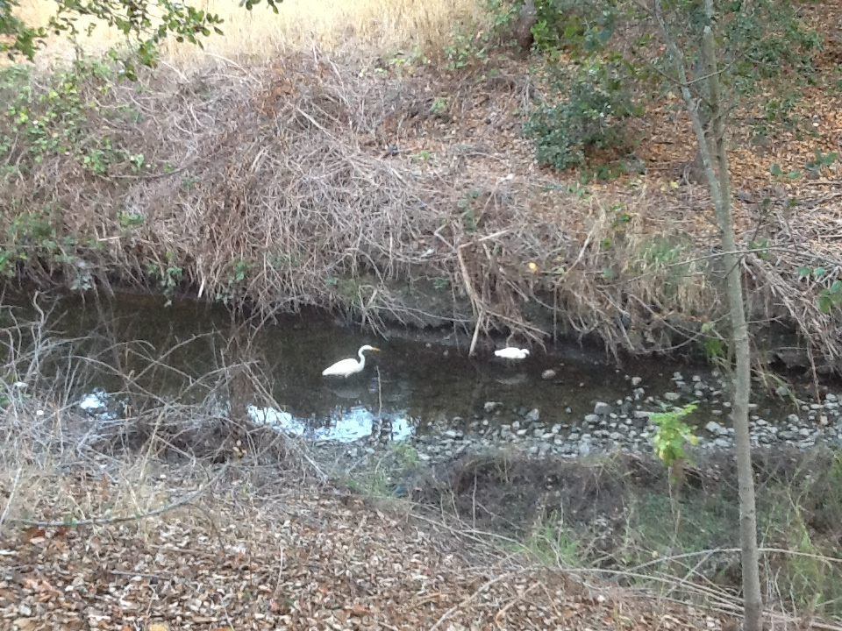
Egrets hunting for food in Colgan Creek, upstream of Hearn Avenue.

Slide 29
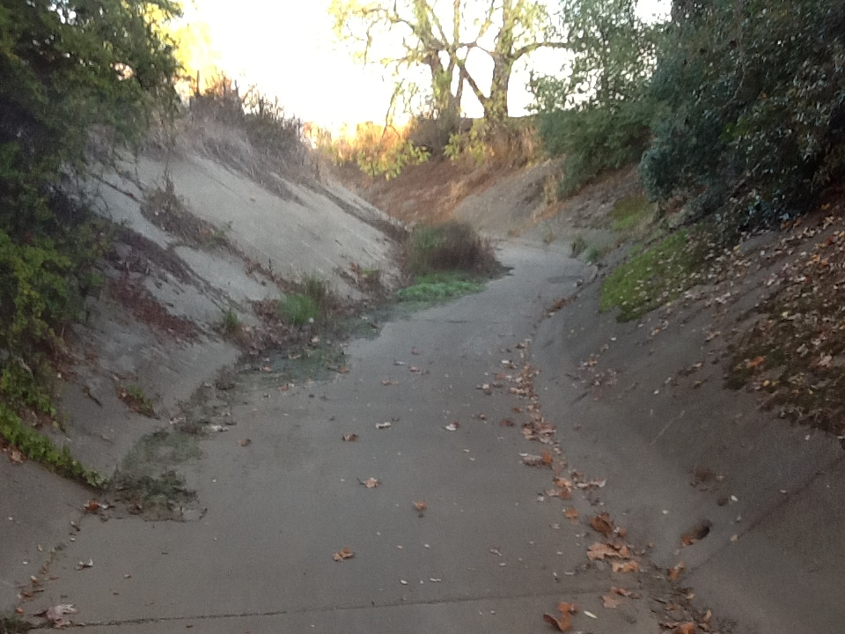
When the creek reaches Victoria Drive, it is again in a concrete channel. The creek is dry in this photo.

Slide 30
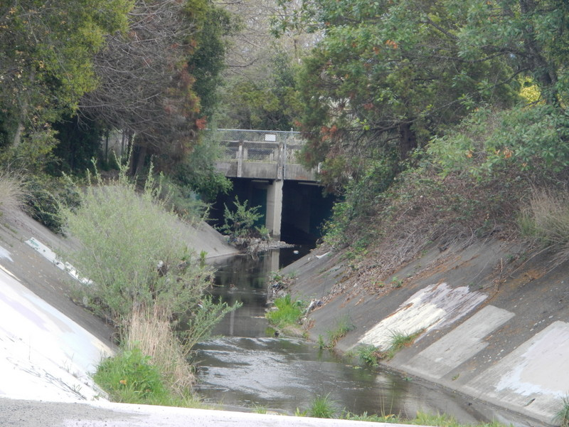
Colgan Creek flowing under Victoria Drive.

Slide 31
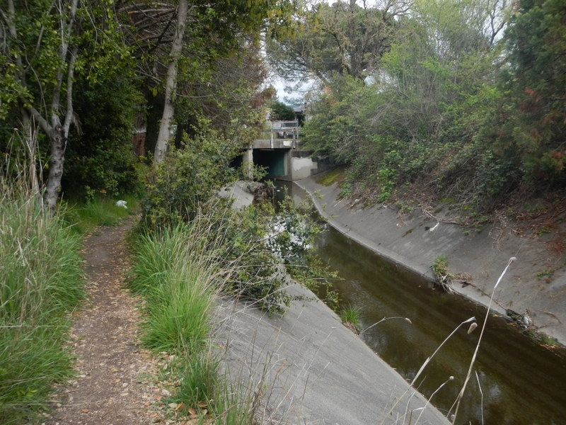
Trail along the creek near Victoria Drive.

Slide 32
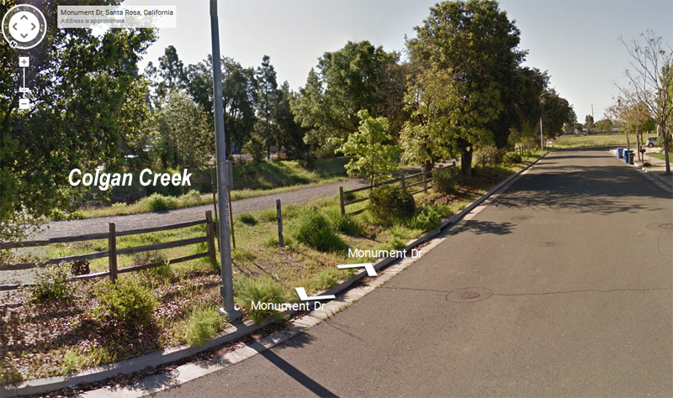
The creek flows along Monument Drive and then across Dutton Meadow. There is a trail next to the creek here.

Slide 33
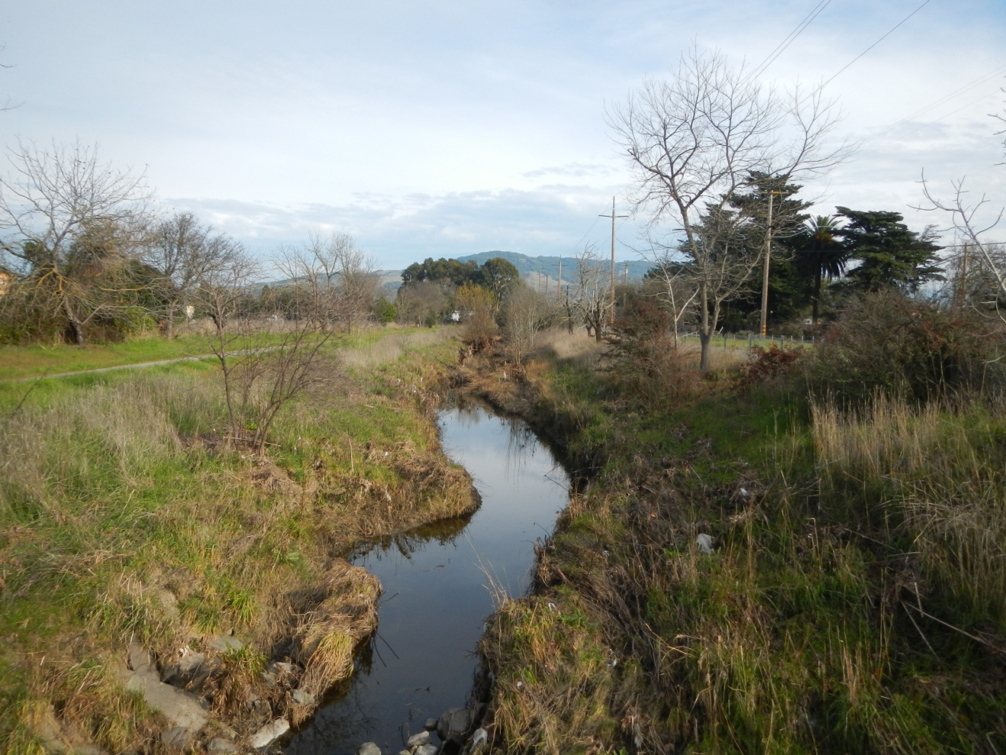
Looking upstream from Bellevue Avenue.

Slide 34
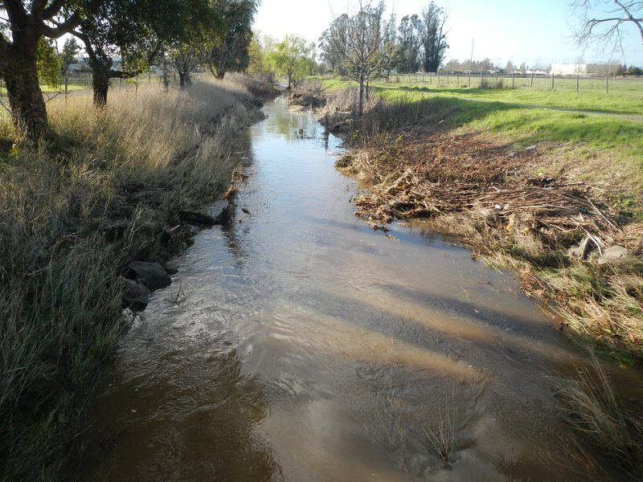
Looking downstream from Dutton Meadow.

Slide 35
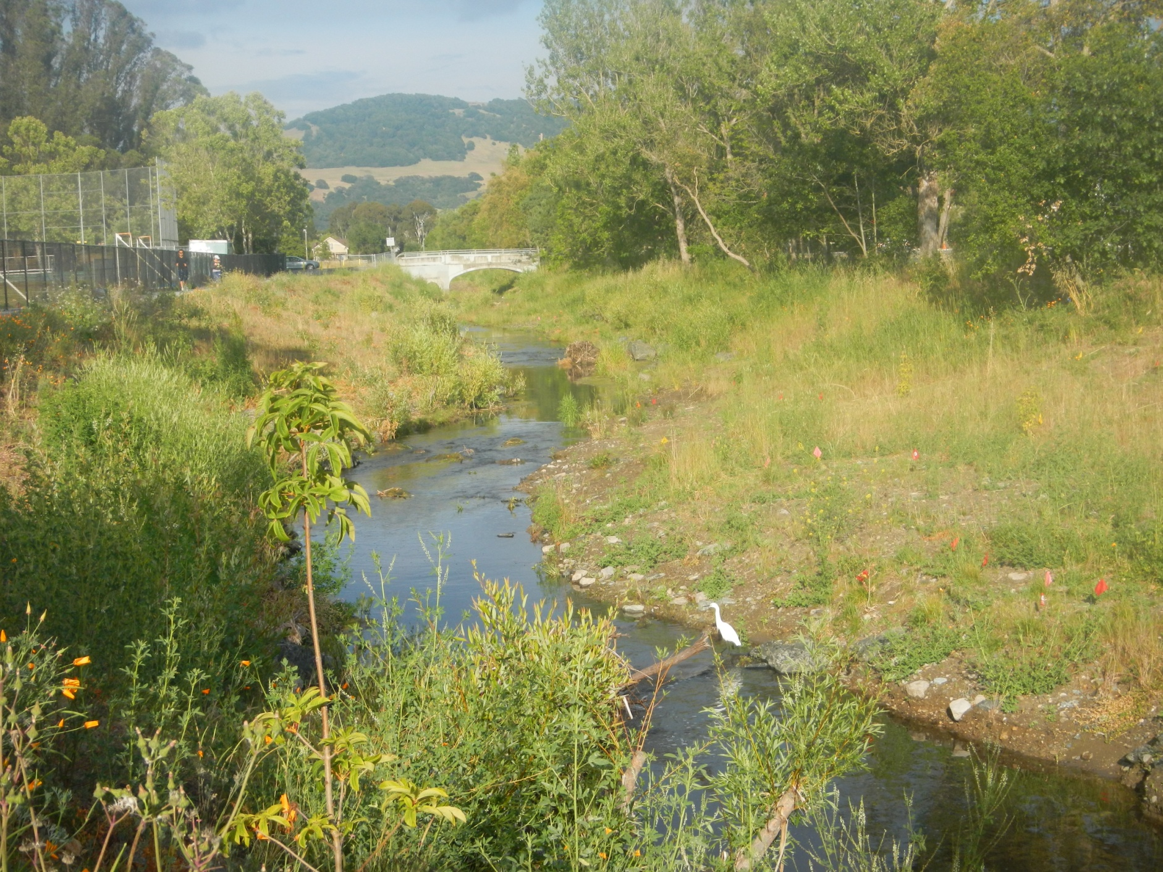
Near Elsie Allen High school, looking upstream at Burgess Bridge and Taylor Mountain.

Slide 36
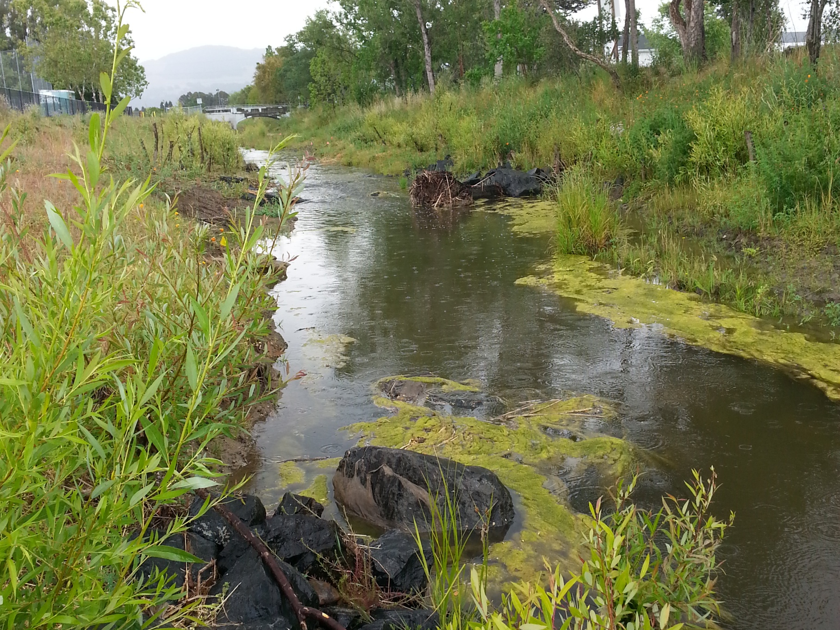
Here is the creek just before it flows under Bellevue Avenue. This is looking upstream. Burgess Bridge is in the far distance.

Slide 37
The Lower Section of Colgan Creek
The lower section of the creek flows through agricultural lands, past the water treatment facility, and finally into the Laguna de Santa Rosa.

Slide 38
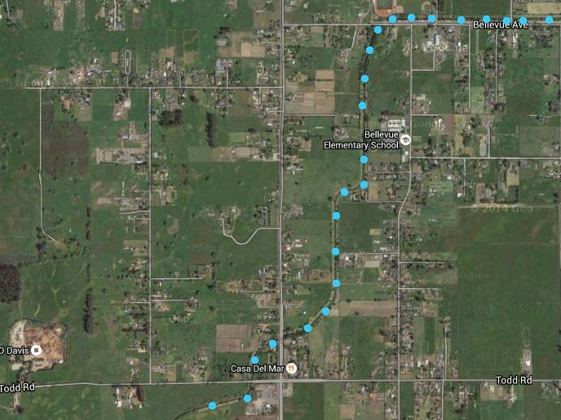
Downstream from Bellevue Avenue, the landscape is less developed.

Slide 39
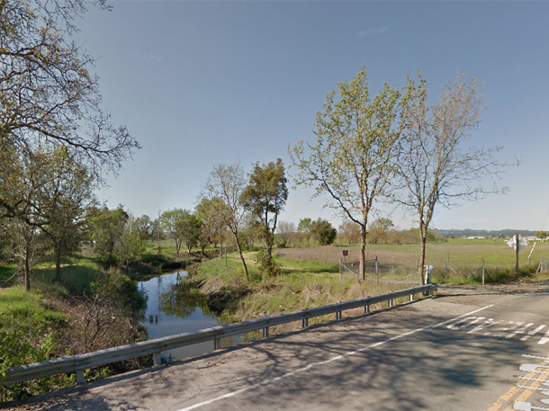
Colgan Creek, as it passes under Todd Road. The landscape is more open here, and is used partly for agriculture.

Slide 40
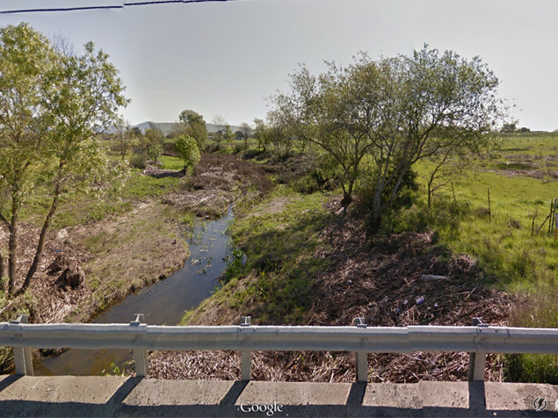
At Llano Road, looking upstream.

Slide 41
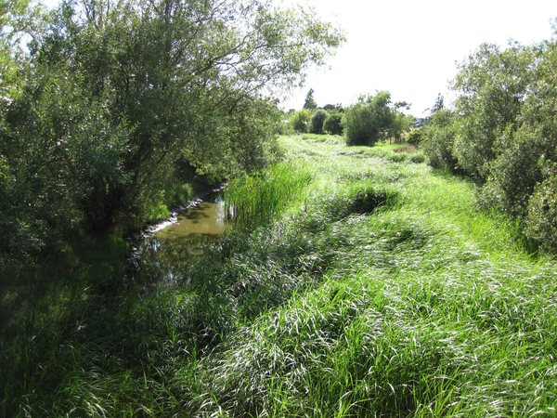
Lower Colgan Creek.

Slide 42
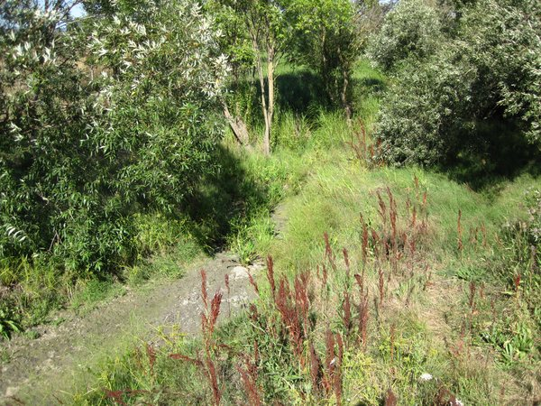
Lower Colgan, just before it flows into the Laguna de Santa Rosa.

